Slide 1
GENZWEAR – Static E-Commerce Fashion Website
Presented By:
Misbah Bibi
Uzair Arshad

Slide 2
INTRODUCTION
GENZWEAR is a static fashion e-commerce website
Designed using HTML5 and CSS3
Targets Gen Z consumers
Focuses on modern UI and easy navigation
Developed as an academic project

Slide 3
BACKGROUND
Rapid growth of online shopping
Gen Z prefers minimal and visually appealing websites
HTML and CSS form the foundation of web development
Static websites are cost-effective and easy to deploy

Slide 4
PROBLEM STATEMENT
Beginner web projects often lack:
  Proper structure
  Consistent styling
  Real-world relevance
Challenge:
  Build a professional fashion website
  Using only HTML and CSS
  Without backend technologies

Slide 5
PROJECT PURPOSE
Apply core front-end development concepts
Understand website structure and navigation
Design a brand-oriented fashion website
Demonstrate real-world website layout techniques

Slide 6
AIMS & OBJECTIVES
Design a multi-page website using HTML
Apply CSS for styling and layout
Create smooth navigation between pages
Simulate a basic e-commerce platform
Improve UI/UX design skills

Slide 7
SCOPE OF THE PROJECT
Included:
Home Page
Shop Page
Product Detail Page
Cart Page
About Page
Contact Page
Not Included:
Backend functionality
Payment system
User authentication

Slide 8
TOOLS & TECHNOLOGIES USED
Hardware: Laptop / Desktop
Software: Visual Studio Code
Technologies: HTML5, CSS3
Browser: Google Chrome
Assets: Images & icons

Slide 9
DESIGN METHADOLOGY
Planning website layout
Creating HTML page structure
Applying centralized CSS
Linking pages using navigation menu
Testing layout and responsiveness

Slide 10
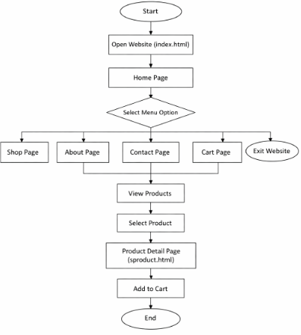
WEBSITE FLOWCHART
Home page as entry point
Navigation links to:
Shop
Product Details
Cart
About
Contact
Ensures smooth user navigation

Slide 11
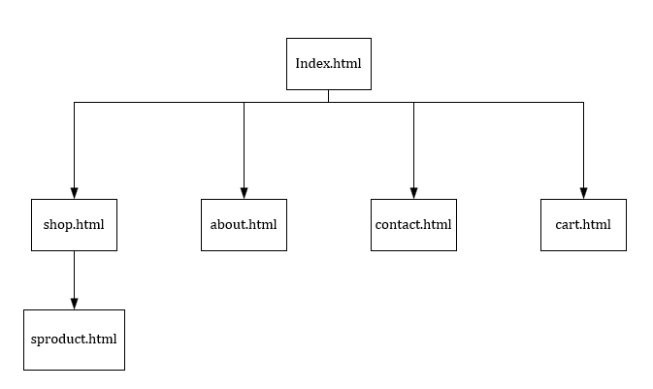
WEBSITE STRUCTURE
index.html → Home page
shop.html → Product listing
sproduct.html → Product details
cart.html → Cart page
about.html → Brand information
contact.html → User contact form

Slide 12
IMPLEMENTATION
Created separate HTML files for each page
Used semantic HTML tags
Linked a single CSS file for styling
Designed header, footer, and navigation bar
Styled buttons, product cards, and images

Slide 13
Results
Website loads successfully
Consistent design across all pages
Navigation links work properly
Product images display correctly
Clean and professional layout achieved

Slide 14
Result Analysis
Page | Functionality | Status
Home | Navigation | Working
Shop | Product Listing | Working
Product | Product Details | Working
Cart | Item Display | Working
Contact | User Info | Working

Slide 15
Limitations
No backend or database
Static content only
No real checkout system
No login or authentication

Slide 16
Environmental aspects
Promotes paperless shopping
Reduces printed catalogs
Static website uses minimal server resources
Supports eco-friendly digital practices

Slide 17
CONCLUSION
Successfully developed a static fashion website
All objectives were achieved
Demonstrated strong understanding of HTML & CSS
Project shows real-world application of front-end concepts

Slide 18
RECOMMENDATIONS & FUTURE WORK
Add JavaScript for interactivity
Implement backend using PHP or Node.js
Integrate database for products
Improve mobile responsiveness

Slide 19
THANK YOU!😘

